Slide 1
What Makes a Good Maths Resource?
Practical Considerations when Creating or Adapting Resources for the Secondary Classroom
Amanda Austin
@draustinmaths

Slide 4
What Makes a Good Maths Resource?
Practical Considerations when Creating or Adapting Resources for the Secondary Classroom
Amanda Austin
@draustinmaths

Slide 5
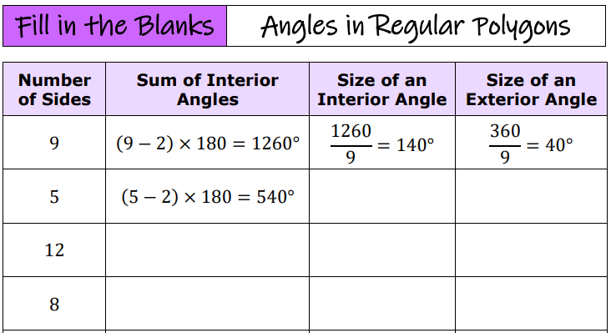
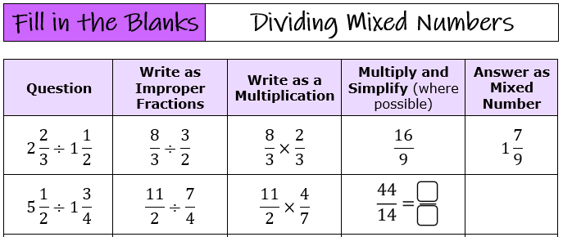
Is it easy to get started?
1
Worked
Examples

Slide 6
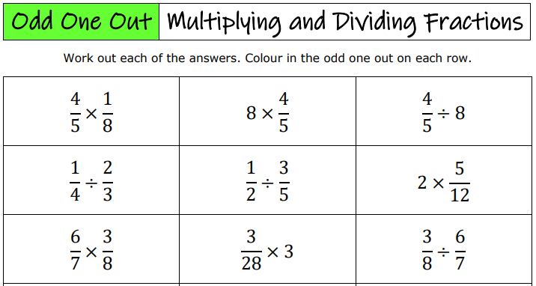
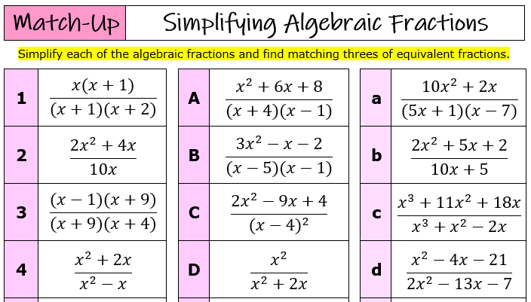
Is it easy to get started?
1
Clear
Instructions

Slide 7
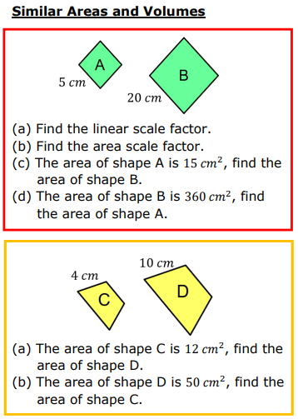
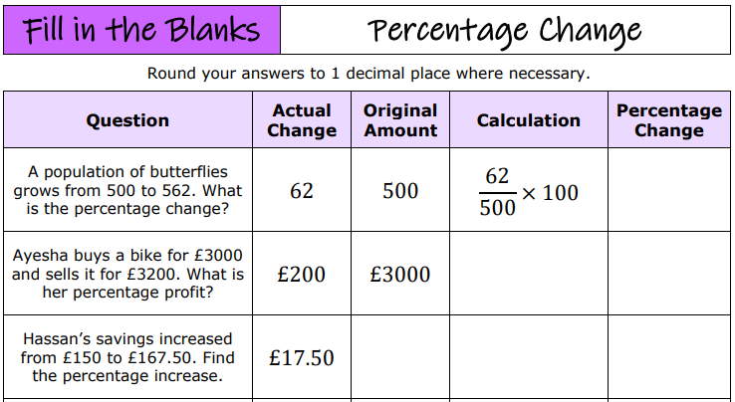
Is it easy to get started?
1
Scaffold by splitting questions into multiple steps

Slide 8
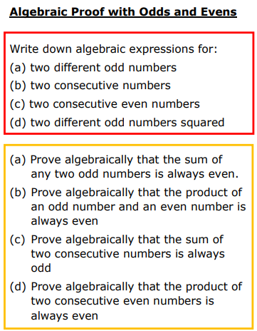
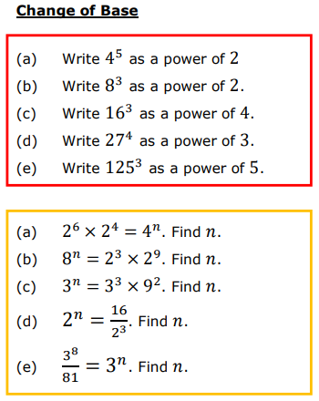
Is it easy to get started?
1
Scaffold
by practising
pre-requisite
skills

Slide 9
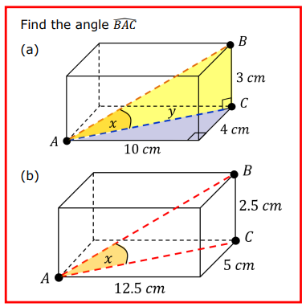
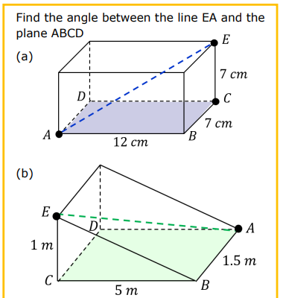
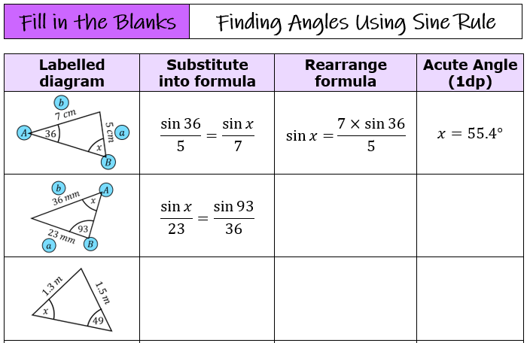
Is it easy to get started?
1
Scaffold
with diagrams

Slide 10
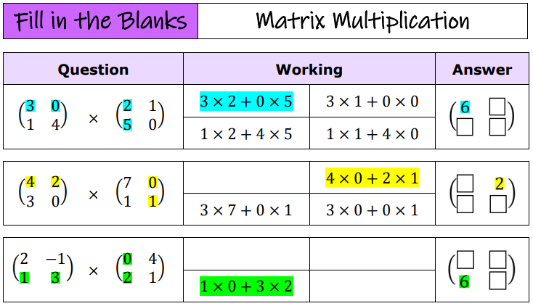
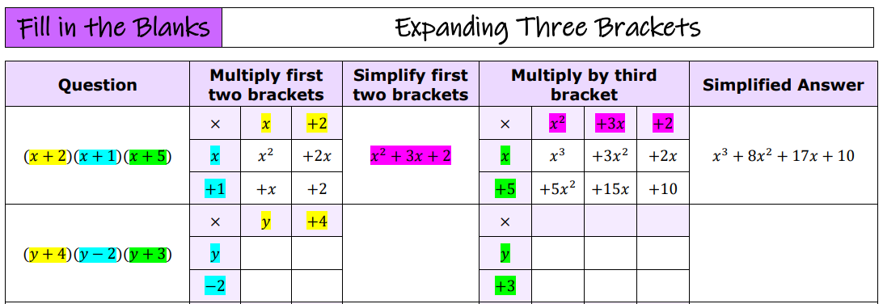
Is it easy to get started?
1
Scaffold
using
colour

Slide 11
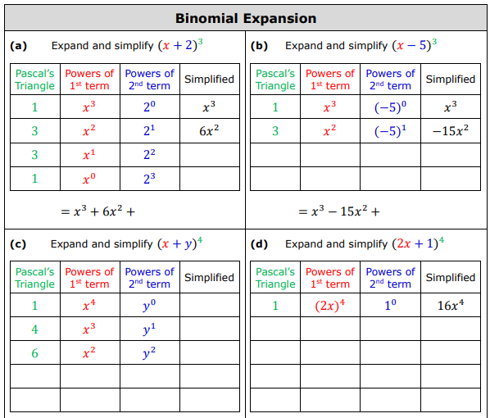
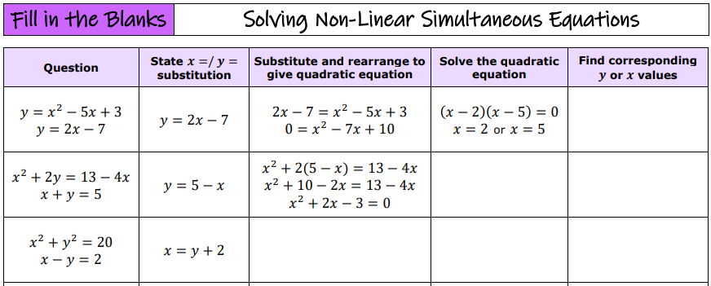
Does it build confidence?
2
Backwards fading

Slide 12
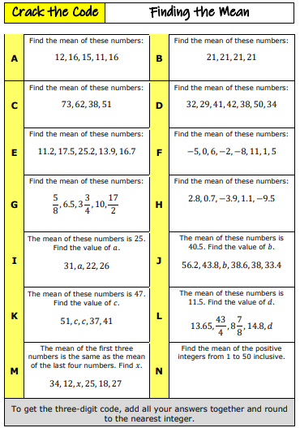
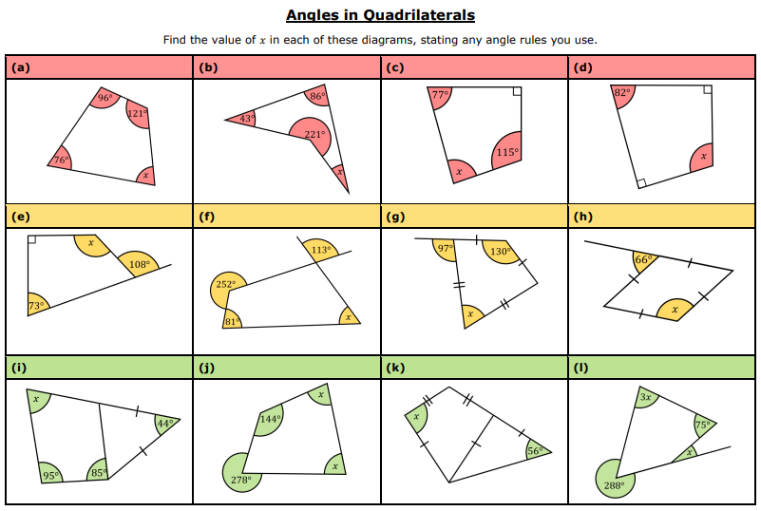
Does it build confidence?
2
Increasing in difficulty

Slide 13
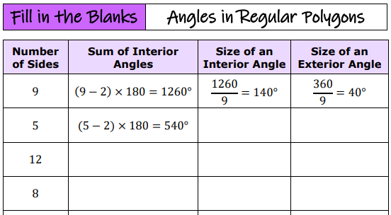
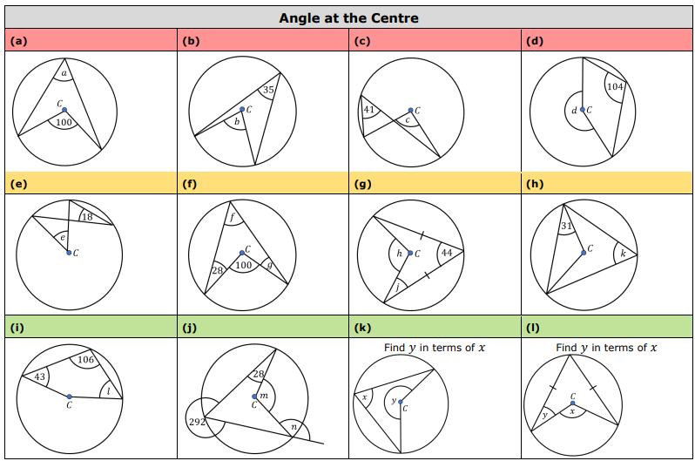
Does it provide challenge?
3
Generalisation

Slide 14
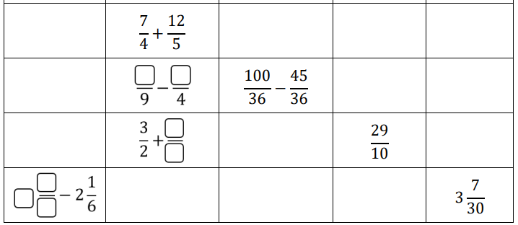
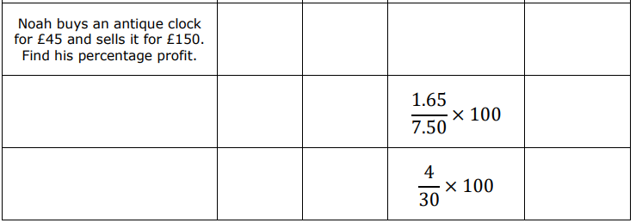
Does it provide challenge?
3
Working backwards

Slide 15
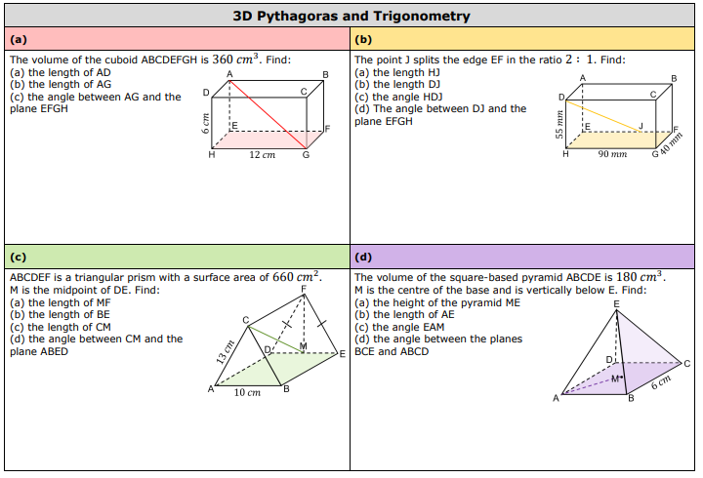
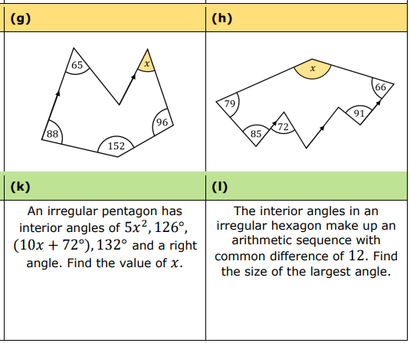
Does it provide challenge?
3
Interweave with
other topics

Slide 16
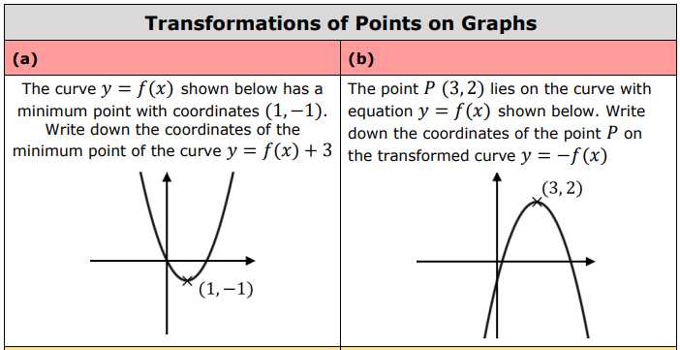
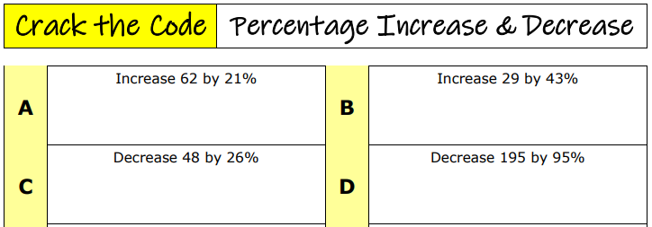
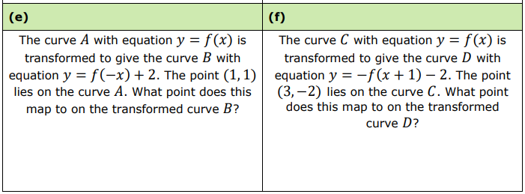
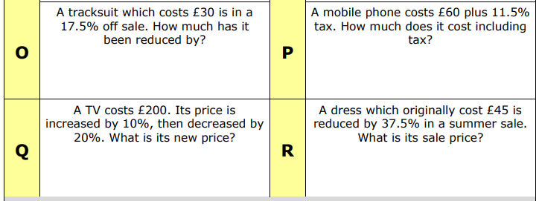
Does it provide challenge?
3
Worded problems

Slide 17
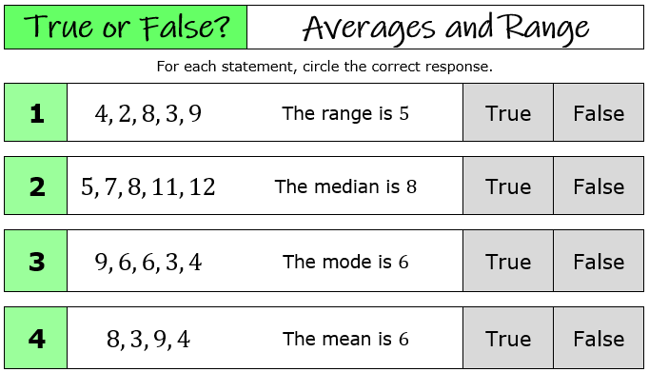
Does it address misconceptions?
4
True or
false?

Slide 18
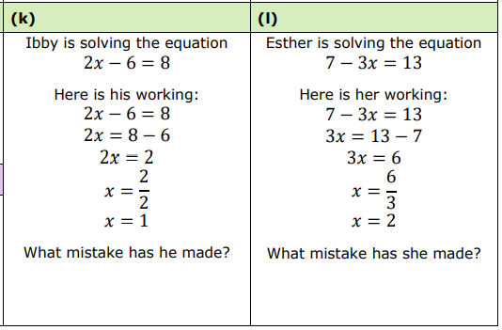
Does it address misconceptions?
4
Spot the
mistake

Slide 19
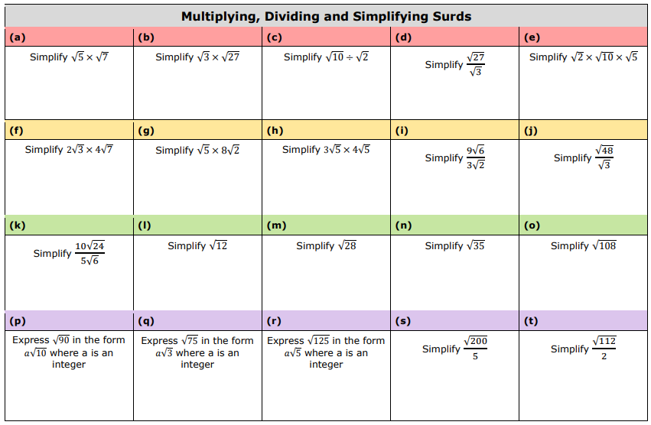
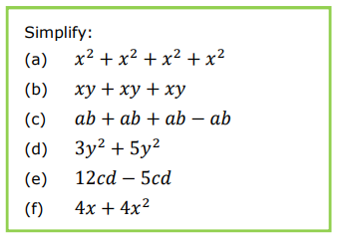
Does it address misconceptions?
4
Non-examples
and impossible
answers

Slide 20
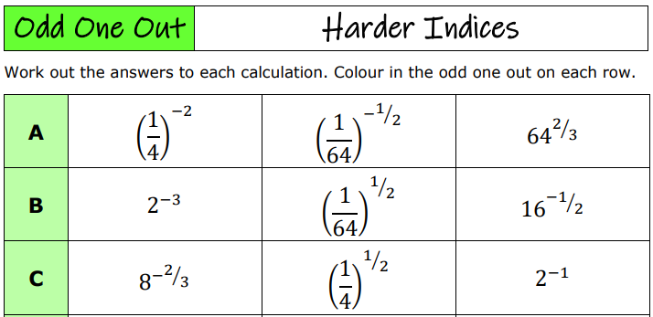
Is it ‘good value’?
5
No wasted space
or distractions

Slide 21
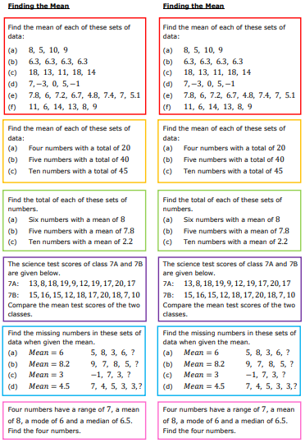
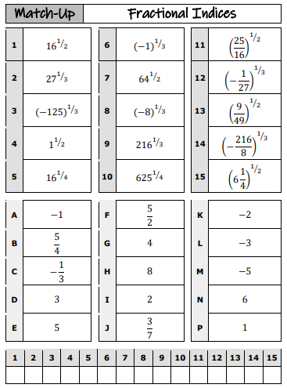
Is it ‘good value’?
5
Printer-budget friendly!

Slide 22
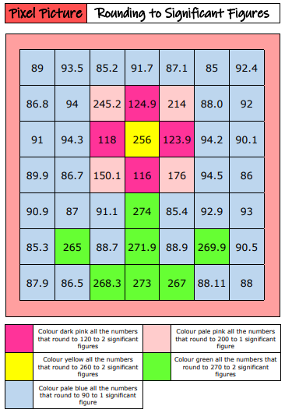
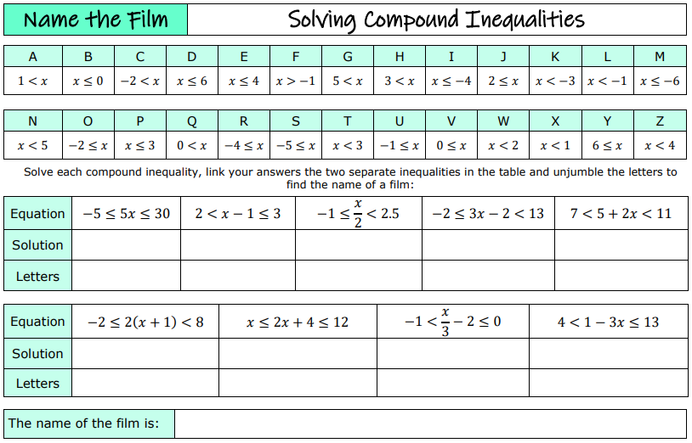
Is it ‘good value’?
5
Time spent ‘doing maths’ >
Time spent doing other things

Slide 23
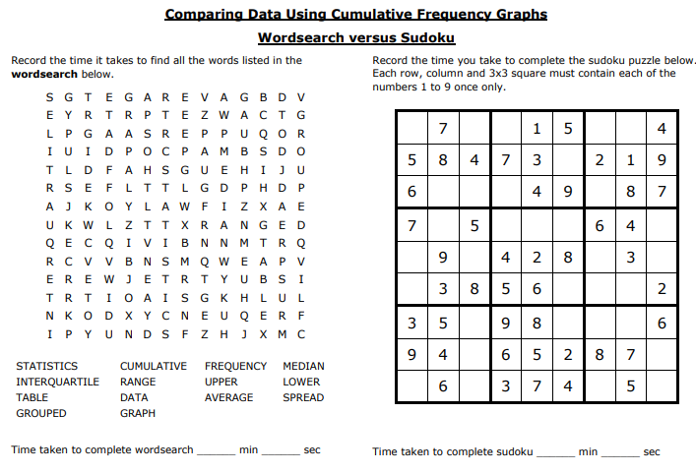
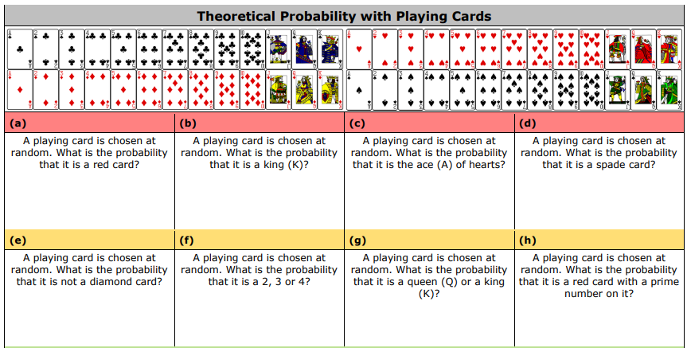
Other miscellaneous things…
6
Assumed
knowledge

Slide 24
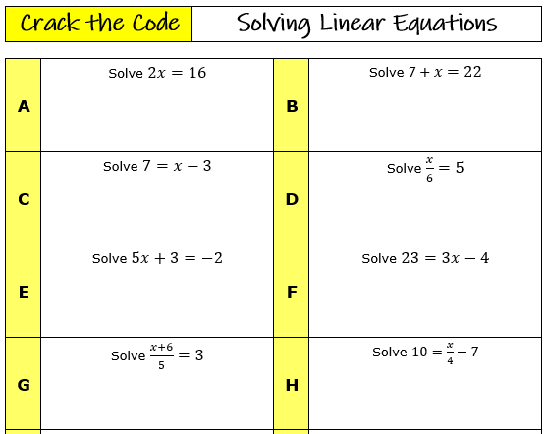
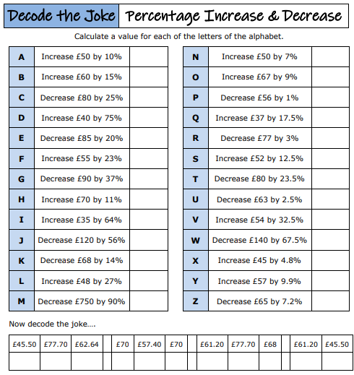
Other miscellaneous things…
6
Motivation

Slide 25
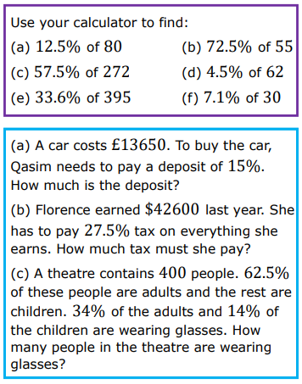
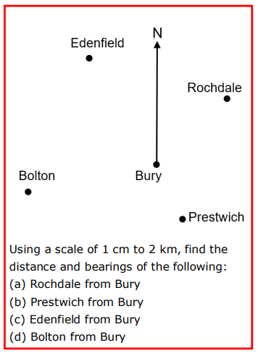
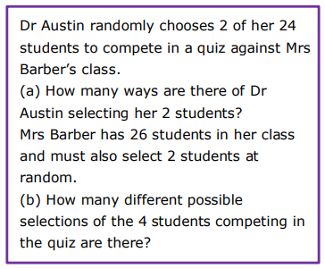
Other miscellaneous things…
6
Personalise it
for your class

Slide 26
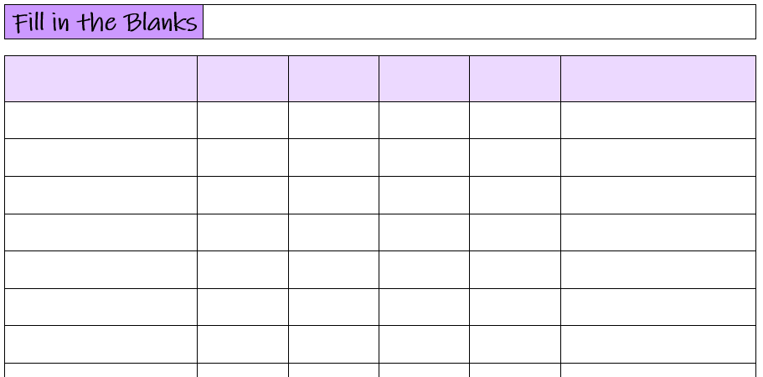
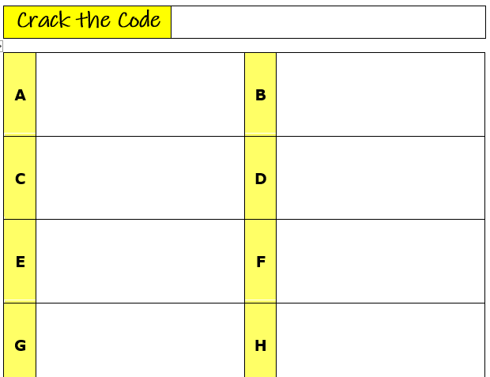
Over to you….
Create or adapt
a resource

